Slide 1
CHALLENGES WITH PROCUREMENT REFORM
CARIBBEAN PERSPECTIVE
November 29, 2016
Presented by: Cheryl Mathurin

Slide 2
DRIVING FORCES OF REFORM
National Economy – taxpayers, Private Sector
Regional – Opportunities, Agreements
International –Donors, IMF, International Community
Global Economy

Slide 3
PROCUREMENT LANDSCAPE
CSME 20% of GDP 15.90Billion; (2015 IMF)
CARIFORUM 20% of GDP US$28.73 Billion in 2015 - biggest markets are Dominican Republic, Trinidad and Tobago and Jamaica (Bahamas, Suriname, OECS, Haiti)
, uti

Slide 4
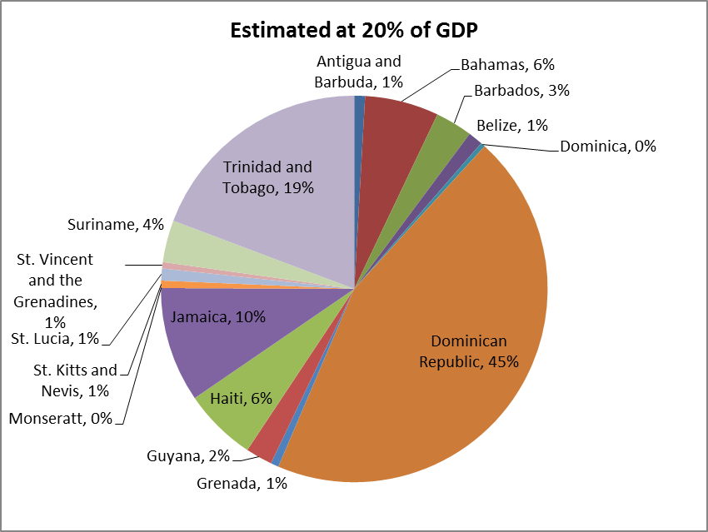
MARKET SHARE -

Slide 5
INVESTORS PERCEPTIONS 2016
COUNTRY | RANKING | SCORE
Haiti | 158 | 17
Guyana | 119 | 29
Dominicans Republic | 103 | 33
Suriname | 88 | 36
Trinidad And Tobago | 72 | 39
Jamaica | 69 | 41
Barbados | 24

Slide 6
INVESTORS PERCEPTIONS

Slide 7
PERCEPTION OF THE POLITICIAN
Public Administration Is Weak
Public Administration Does Not Work Well
Ineffective Compared To Private Sector
Not Results Oriented
Poor performance is acceptable
What are the “Tangible Results” in the context of time and cost in particular re-building
Culture of “Corruption”
Notes:
PUBLIC PROCUREMENT NEEDS TO SUPPORT BROAD POLICIES OF GOVERNMENT ; DEVELOPMENTAL TOOL

Slide 8
CONCERN OF THE CITIZEN
Should it be, that public procurement is expected to contribute to my quality of life through community services and infrastructure “why are we always paying for the same things” – rebuilding, Increase Unemployment, poor social conditions, limited housing.
Notes:
PUBLIC PROCUREMENT NEEDS TO SUPPORT BROAD POLICIES OF GOVERNMENT ; DEVELOPMENTAL TOOL

Slide 9
PERCEPTION OF THE SUPPLIER COMMUNITY
Waste of time
Same people are getting the jobs
Absence of approved standards
Notes:
PUBLIC PROCUREMENT NEEDS TO SUPPORT BROAD POLICIES OF GOVERNMENT ; DEVELOPMENTAL TOOL

Slide 10
Challenges In The Caribbean
POLITICAL CLIMATE
BENEFITS VS COST
TIME – 5 YEARS TO SHOW RESULTS AND IMPACT
TRANSLATING INTENDED IMPACTS THROUGH PUBLIC PROCURMENT
Improve quality of learning
provide access to health care, basic infrastructure
Translating policies to impact
STANDARDS e.g construction

Slide 11
Challenges in the Caribbean
LEGAL
Ethics and Corruption – Changing the “mindset”/ Change Management
Harmonization of procurement environments
Centralised vs Decentralized
Fiscal space – debt
Differences in the taxation, employment and subsidy systems
Political interference
Policy Changes – change in Governments

Slide 12
Challenges in the Caribbean
ORGANIZATIONAL
Lack of a comprehensive approach to the reform: Absence of Public Sector Reform
Weak – Financial Management Systems Budgeting and Planning
Silo Operations
Inexperienced staff
Weak institutions – Internal and External Audit
Non Functioning Public Accounts Committee

Slide 13
Challenges in the Caribbean
ORGANIZATIONAL
Lack of Strategic Direction
Overlap of roles and duplication
Limited human resource particularly in the smaller member states
Changes in senior staff = loss of corporate memory
Inadequate Oversight (M&E ) due to conflicting roles/ legislation

Slide 14
Challenges in the Caribbean
RESOURCES
Funding for the smaller Members in the Region
Professionalization (Training and Certification)
Limited skills/experience
Poor infrastructure – Information Technology Systems
Especially for records retention

Slide 15
Challenges in the Caribbean
PROCEDURAL
Evaluation of Suppliers
Absence of Procurement planning (not linked to Budget Planning)
Excessive Bureaucratic operations- control
Supplier Engagement
Enforcement

Slide 16
Challenges in the Caribbean Region
CSME
Need for strong Advocacy / Champion
AT THE NATIONAL, COTED, COFAB
Need for mutual recognition of Professionals – engineers, architects, certifying bodies, economists, public administrators/policy strategists
Need to translate the training material in French (Haiti) as well as PSOPs and SBDs should be translated soon for consultation
The platform should have 3 interfaces: English, French and Dutch. Clicking on the flags you should be able to move from a language to the other.

Slide 17
Challenges in the Caribbean Region
CSME
Economic Recession
Inflation
Exchange rate
Vulnerabilities to Climate Change and Weather Related Phenomena

Slide 18
MAKING THE PARADIGM SHIFT
NETWORKS – INGP
CSME TASKFORCE – COORDINATED APPROACH TO REFORM
INCREASED FOCUS ON REFORMS : LEGISLATIONS, ORGANISATIONAL CHANGE, CAPACITY BUILDING
ADVANCING PROFESSIONAL KNOWLEDGE

Slide 19
MAKING THE PARADIGM SHIFT
CDB – ONLINE TRAINING
WORLD BANK ASSISTANCE – OECS – HARMONIZED LEGISLATION, CERTIFICATION : UTECH AND CIPS
CARICAD – ASSISTANCE WITH STRATEGIC PLANS TO GUIDE REFORM

Slide 20
MAKING THE PARADIGM SHIFT
RECOGNITION FOR ADVANCES IN PROCUREMENT REFORM
LEADERSHIP AWARD

Slide 21
Procurement Professional – “This is a development Tool”
To deliver value for money “we require” knowledge of law, business practices, market segments, economic development issues, financial management , monitoring, evaluation and reporting, contract management and risk management.
Therefore this is NOT a clerical Job .

Slide 22
THANK YOU!!
FOR MORE INFORMATION
CONTACT: Cheryl Mathurin – Saint Lucia
Chairperson – CSME TASK FORCE ON PUBLIC PROCUREMENT

